Slide 1
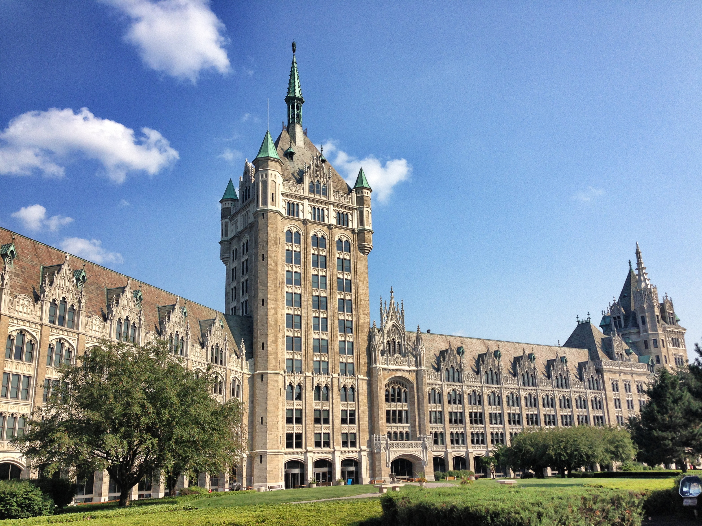

An Introduction to Campus Let Contracts
For State Operated Campuses
Webinar Series
December 2023

Slide 2

Course Objectives
Increase knowledge and understanding of:
Financial Management of Capital Funds
Procurement Requirements
Consultant Selection

Slide 3

Office for Capital Facilities
Visit our Website
To be added to the CLC listserv email jessica.miller@suny.edu
Guidance Documents
Newsletters
Listservs
  Campus Let Contracts Program
  Community College Capital Program
  Energy Procurement and Utility Regulatory Affairs
  Residence Hall Capital Program

Slide 4
Campus Let Contracts
Guidance Documents
  CLC-1 Construction Bonds
  CLC-2 Temporary Services
  CLC-3 Construction Authority
  CLC-4 Contract Threshold Chart
  CLC-5 Division of Budget Approval B-1184
  CLC-6 Debriefing
  CLC-7 Single/Sole Source, Specific Allowances
  CLC-8 Field Orders
  CLC-9 Furniture, Fixtures and Equipment
  CLC-10 Insurance Limits
  CLC-11 Approval of Real Property Transactions
  CLC-12 Telecommunications Site Manager Agreement
  CLC-13 Facilities Procurement Purchase and Install and Service Contracts
  CLC-14 Leases and Revocable Permits
Visit our Website

Slide 5



Campus Let Contracts
Session 3:
Consultant Selection

Slide 6
Learning Objectives
  Increase knowledge and understanding of:
  The process for consultant selections
  The procurement requirements associated with consultant selections
  The role of the Minority and Women Owned Business Enterprises (MWBE) Program Coordinator and MWBE participation in consultant selections
Committee chairs: fulfill the requirement in Procedure 7555 to have completed consultant selection training

Slide 7

Construction Related Consultants
Contracts are negotiated with the most qualified consultant
Selections are made on the on the basis of qualifications
An RFP is required for contracts >$25,000
SUNY Procedure #7555
Construction related consultants: Architecture, engineering, geological, landscape architecture or surveying services
NYS Finance Law §136-A

Slide 8

State Finance Law §136-a
It is the policy of New York state to negotiate contracts for architectural, geological, engineering, landscape architecture, and surveying services on the basis of demonstrated competence and qualification for the type of professional services required and at fair and reasonable fees.
Most Qualified
Negotiate

Slide 9
Design Project Procurement
Estimates, Budget, Funding Source
B-1184 (if Capital)
Project Funding Request (if Capital)
Develop RFQ , include MWBE Goals
Advertise (NYSCR)
Consultant Selection
Negotiations and Consultant Forms: MWBE, Procurement Lobbying, Vendor Responsibility Insurance, Consultant Reporting
Contract Award
AG/OSC Approval

Slide 10
Consultant Selection Process
short listed firms must have MWBEs in their staffing plans
Statement of Qualifications (SOQ) are submitted
A short list is developed
Short listed firms are interviewed and evaluated using the rating form
The most qualified consultant is selected
MWBE Program Coordinator reviews the SOQ and provides the GFE form to the selection committee
The cost proposal, and updated staffing list with dollar values is required
Rating Form , cost proposal, and staffing list are provided to PC
PC reviews and signs off on the staffing list
Contract Awarded
MWBE Program Coordinator reviews the completed consultant rating form, cost proposal, and staffing list to evaluate GFE
Waivers

Slide 11

Funding
Campus Let Projects
Campus managed construction projects funded by capital appropriations through the Fund
Campus Administered Procedures apply
Campus Funded Projects
Campus managed construction projects funded by SUNY appropriations or other funds such including those from the Foundation, Research Foundation, Auxiliary Service Corporation, Alumni Association, Income Fund Reimbursable (IFR) accounts or Grants.
Funding Source
Campus Let vs.
Campus Funded

Slide 12
Campus Let Contracts
Projects funded with Capital, follow the Campus Administered Procedures:
  Capital Project Request
  B-1184 Approval - Division of Budget
  B-1223 Approval - Division of Budget (managed through your Fund Program Manager)
  Project Funding Request
Project Funding Requests must be approved by the Fund
prior to placing an advertisement
Campus Administered Procedures

Slide 13

Selection Committee
A minimum of three members are required
If interviews are held, all voting committee members must attend all interviews
At a minimum the committee chair must have completed the Consultant Selection Training

Slide 14

Procurement Lobbying Act
Limits communications during the Restricted Period – from Contract Reporter Ad to Contract Execution
All inquires must be directed to the Designated Contact
Requires vendor affirmation, certification and disclosure of compliance
Applicability: >$15,000
SUNY Procedure #7552
NYS State Finance Law § 139-j

Slide 15

Conflict of Interest
A conflict of interest occurs when the Committee member or an immediate family member (spouse/domestic partner, parent, sibling or child) has a financial interest in or has been employed by any of the firms under consideration within the previous two years.
Contact your campus ethics officer or counsel

Slide 16
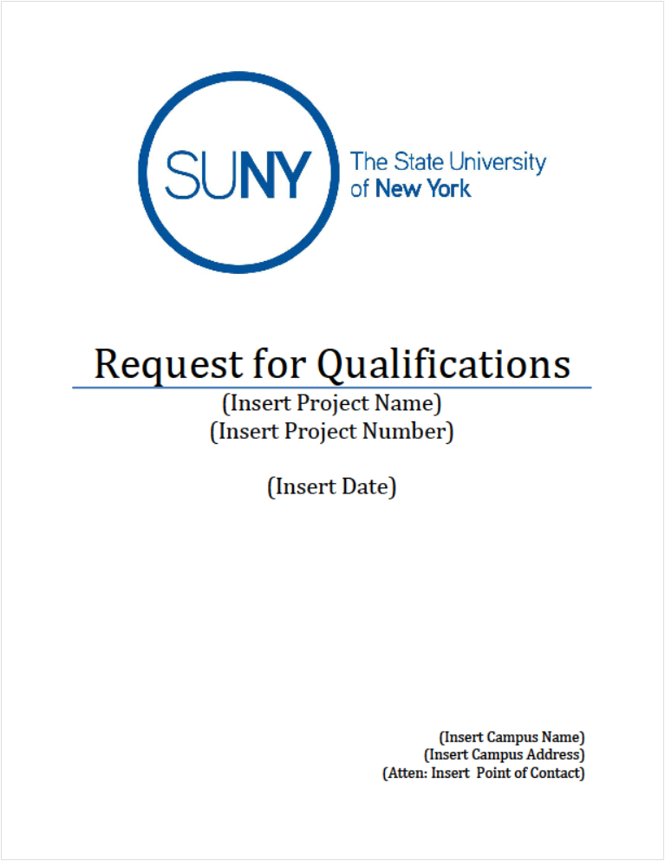
Request for Qualifications
SUNY Form 7555-01

Slide 17

Minority and Women Owned
Business Enterprise (MWBE) Participation
Assign Goals
Applicable on contracts >$100,000 for construction; >$25,000 for commodities, services and construction related services
Set Goals using the Goal Setting Methodology
Governors Aspirational Goals: 30%
SUNY Procedure 7557

Slide 18

Service Disabled Veteran Owned Business (SDVOB) Participation
Assign Goals
Applicable on contracts >$100,000 for construction; >$25,000 for commodities, services and construction related services
Assess contract for SDVOB participation
State-wide goal is 6%
SUNY Procedure 7564

Slide 19

New York State Contract Reporter
Advertisement for at least 15 business days prior to the bid due date
Individual ad for contracts in excess of $50,000
Quarterly ad for anticipated contracts >$10,000 but <$50,000
NYSCR Website
NYS Economic Development Law (§142)

Slide 20

Short List Process
Brief review of all Submittals of Qualifications
Each committee member individually completes a Short List Rating Form (7555-03)
Short List Ratings are complied in the Short List Summary Form (7555-04)

Slide 21
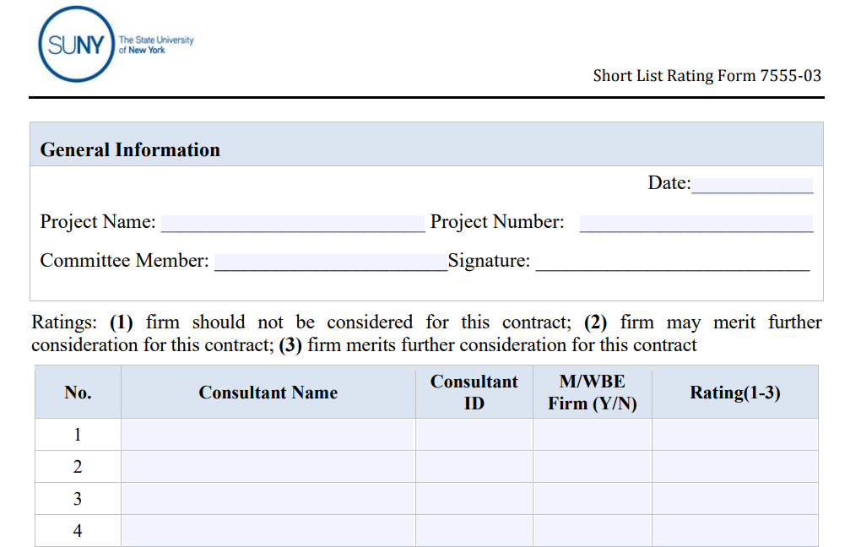
Short List Rating Form
SUNY Form
7555-03

Slide 22
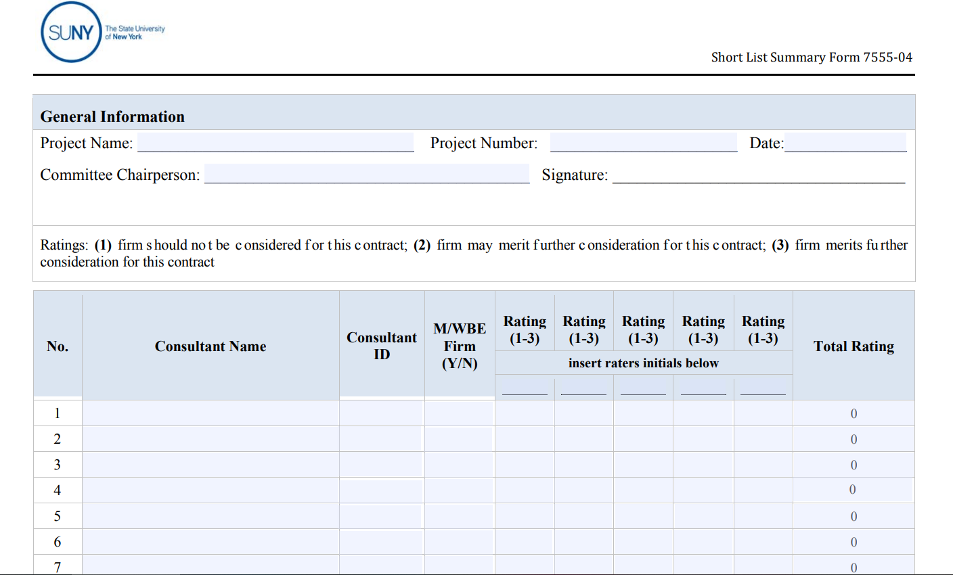
Short List Summary Form
SUNY Form
7555-04

Slide 23
Sub-consultant Staffing List
7555-15 Architecture | 7555-16 Construction Management | 7555-17 Commissioning
Architecture Civil Engineering Landscape Architecture Structural Plumbing/Fire Protection HVAC Electrical Cost Estimating Asbestos/Hazmat Other | CM-Primary Services Pre-Construction-Constructability Review Pre-Construction-Scheduling Cost Estimating Construction Phase Scheduling Safety Review Construction Phase Technical Staffing MWBE & EEO Other | Commissioning Agent Engineering Indoor Air Quality Testing Inspection Services Balancing Other

Slide 24
Short List Process
At a minimum, the five firms with the highest ratings are to continue in the selection process.
  In the event, the fifth and sixth firms’ ratings are tied, both firms are to continue in the selection process.
Ratings may be reconsidered if pool of firms is too large or too small
  Provide the MWBE Program Coordinator copies of the Submittal of Qualifications and Sub-consultant Staffing Lists (SUNY Form 7555-115, 116 or 117) for each short-listed firm

Slide 25

Evaluating Firms
Detailed review of Submittal of Qualifications
Site visits and interviews, as applicable
Contact references (Form 7555-07)
Committee members individually complete the Consultant Selection Rating Form (7555-06)
Score in ink.
Do not write comments on the score sheets.

Slide 26
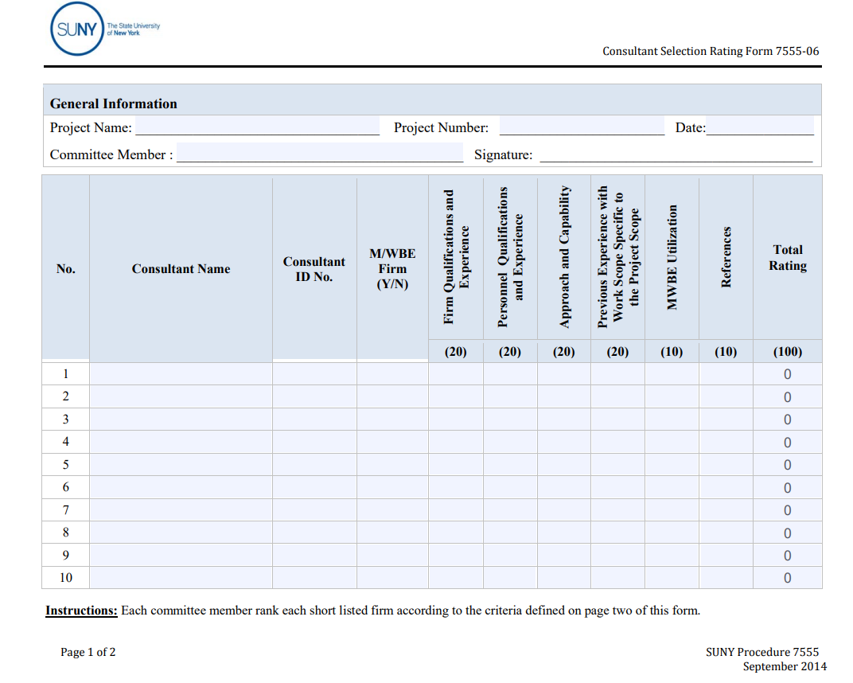
Consultant Selection Rating Form
SUNY Form
7555-06

Slide 27
Consultant Selection Rating Form
    Firm Qualifications and Experience (20 Pts.)
    Personnel Qualifications & Experience (20 Pts.)
    Previous Experience with Work Specific to Project Scope (20 Pts.)
    Approach & Capability (20 Pts.)
    MWBE Utilization (10 Pts.)
    References (10 Pts.)

Slide 28
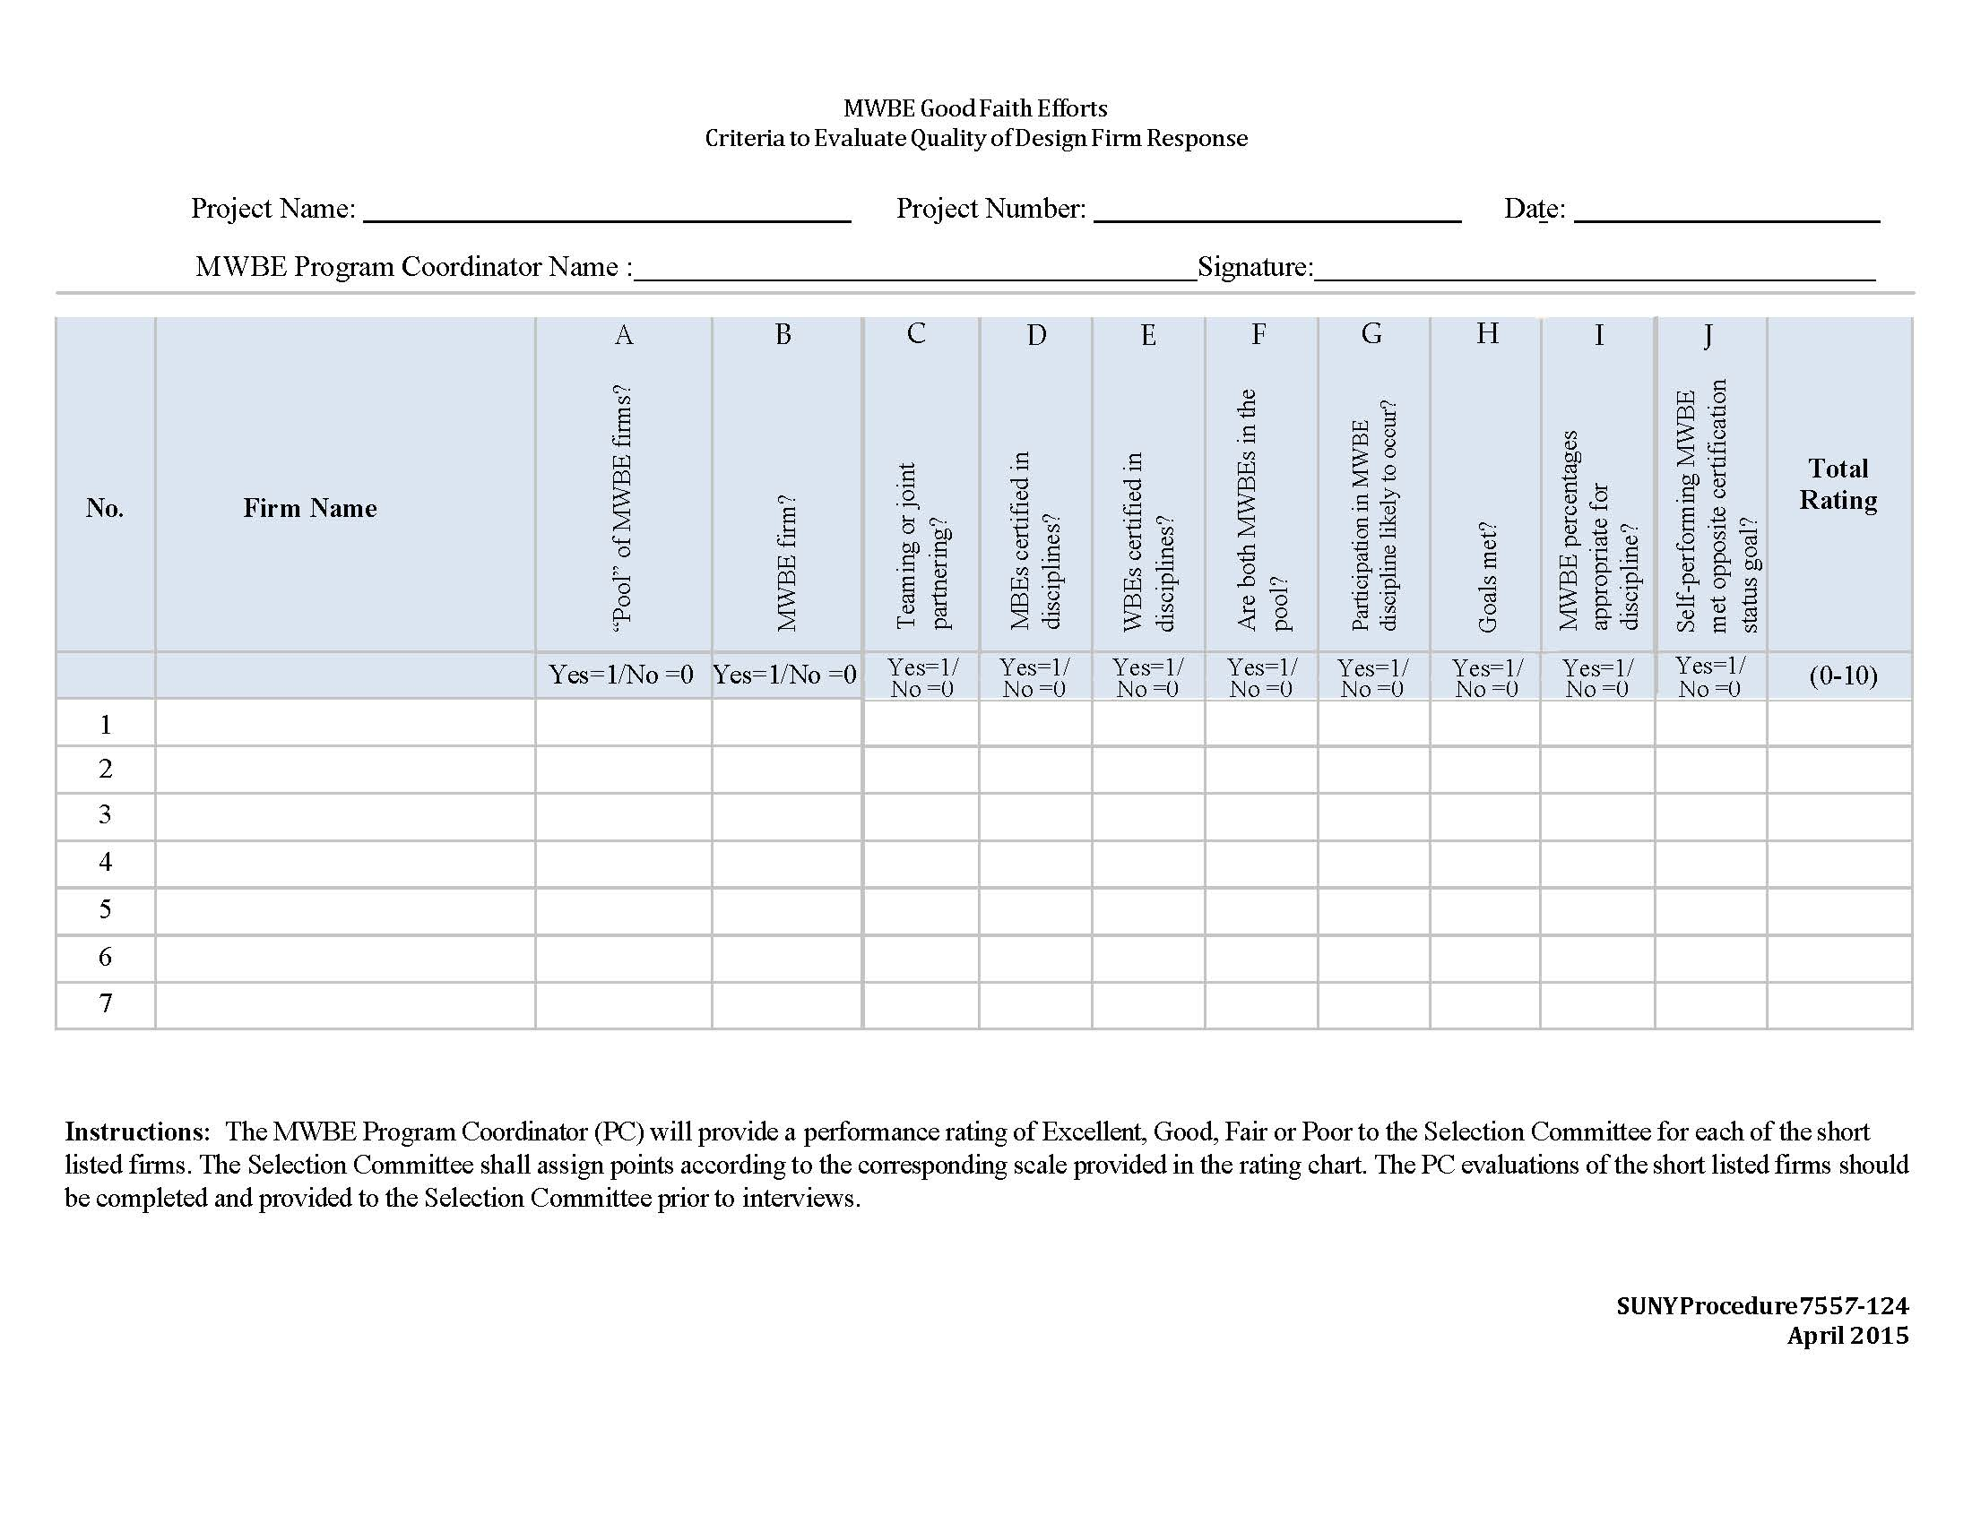
MWBE Program Coordinator
Evaluates Good Faith Efforts and provides the GFE Form (7557-124) to the selection committee
The selection committee uses this information to determine the MWBE rating on the Consultant Selection Rating Form (7555-06)
SUNY Form
7557-124

Slide 29
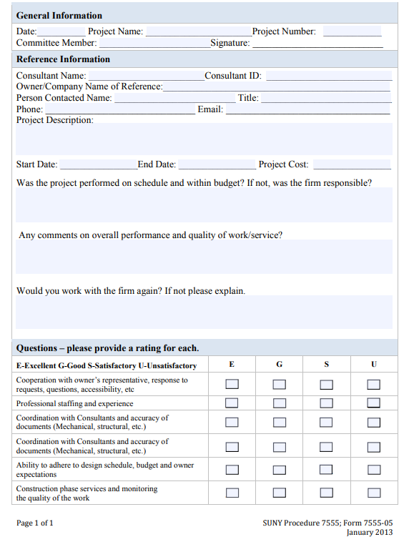
References
One staff member can contact references
That information is then provided to all committee members
SUNY Form
7555-05

Slide 30
Evaluating Firms

Slide 31

Make Selection
Compile the Selection Committee members individual scores
The highest ranking consultant is determined by calculating the average of all Selection Committee member’s scores
Forward a Letter of Intent (Form 7555-08) to the most qualified consultant
Forms available online

Slide 32
Negotiate a Fair and Reasonable Fee
Request and evaluate the cost proposal
    Hours
    Rates
    Multipliers
No cost proposals are to be submitted with the qualifications. Cost proposals are to be requested after a consultant selection is made.

Slide 33
Substantiating Fee
Option | Option
Fee Schedule Method | Standard Multiplier Method
We recommend doing both and submitting ONE; choose the approach that best fits the procurement

Slide 34
Fee Schedule Method
Fee Proposals
Require the consultant to submit EITHER a cost proposal in their own format, OR a cost proposal worksheet supplied by the campus
Recommendation: require the consultant to state the multiplier used in that proposal and complete the OGS Multiplier Calculation Worksheet
Evaluate the cost proposal
  Tasks / Design Phases
  Hours
  Labor Categories
  Rates

Slide 35
Fee Schedule Method
Comparison to the Fund’s Fee Schedule
Enter the estimated construction value and complexity factor into the worksheet
Complexity factors for interior renovations are generally 1.5
  OSC may accept complexity factors up to 1.6 on a case-by-case basis. Be prepared to substantiate a higher complexity factor.
Considerations: The SUNY contract does not include Extra Compensation Agreements (ECAs). On some projects, this may impact how well the fee schedule aligns with consultant proposals.

Slide 36
Standard Multiplier Method
Require the consultant to submit EITHER a cost proposal in their own format, or a cost proposal worksheet supplied by the campus
Require the Consultant to complete the OGS Multiplier Calculation Worksheet for multipliers more than 2.7
Require a FAR Part 31 Audit for multipliers more than 2.9

Slide 37
Standard Multiplier Method
Fee Proposals
Require the consultant to submit EITHER a cost proposal in their own format, OR a cost proposal worksheet supplied by the campus
Recommendation: require the consultant to state the multiplier used in that proposal
Evaluate the cost proposal
  Tasks / Design Phases
  Hours
  Labor Categories
  Rates

Slide 38

What are multipliers????

Slide 39
Multipliers
The Multiplier is the adjustment factor used to represent a firm’s overhead costs and profit, applied to their Direct Labor costs.
Overhead costs – a firm’s INDIRECT labor and operating expenses which are not DIRECTLY billable against a contract (G&A)
  Office Expenses – office supplies, maintenance, printing/reproduction
  Payroll/Salary expense – Payroll taxes (FICA, UI)
  Building Expenses – Utilities, maintenance, building insurance, property tax
  Professional Expenses – Professional training/education, professional dues, licensing or registrations, seminars and conventions, bid and proposal costs
  Transportation Expenses – Depreciation of company owned vehicles, supplies, maintenance, taxes, registration, insurance
  Communication Expenses – Telephones, postage and shipping
  Outside Services Expenses – Legal or Accounting expenses; other consultant services expenses

Slide 40
Multipliers
Overhead multipliers are calculated as a percentage of a firm’s overhead costs divided by the direct labor cost
Example:
  Direct Labor Expense Total: $1,350,000 = 1 direct multiplier
  Indirect Labor/Op Exp Total: $2,000,000
  Direct Labor Expense Total: $1,350,000 = 1.48 indirect multiplier
  Multipliers = 1.0 + 1.48 =2.48 Base OH multiplier

Slide 41
Multipliers
Profit is the firm’s financial gain and is a component of the multiplier.
      Example:
      Base OH Multiplier 2.48
      Profit % 15%
      Profit as a Multiplier (2.48*.15) = 0.37
      Total Multiplier (2.48+.37) = 2.85

Slide 42
Multipliers
Allowable vs. Unallowable Indirect Expenses are specified under the Federal Acquisition Regulations (FAR) Part 31 Contract Cost Principles and Procedures (available online)

Slide 43
Negotiating Multipliers
Multiplier of 2.7 or less
  No substantiation required
Multipliers >2.70 but <2.90
  Require the OGS Multiplier Calculation Form (BDC 3) including annotated financials to support the firm’s entries
  Review the OGS Multiplier Calculation form and annotated financials
  Profit is not allowed beyond 15%.
  Conduct negotiations as applicable with the firm.

Slide 44
Negotiating Multipliers
Multipliers > 2.90
  Require the OGS Multiplier Calculation Form (BDC 3) including annotated financials to support the firm’s entries
  Review the OGS Multiplier Calculation form and annotated financials
  Require the firm to provide a copy of an independent third party FAR Part 31 Audit to support their request (audit of the most recent year)
  Profit is not allowed beyond 15%.
  Conduct negotiations as applicable with the firm.

Slide 45
Negotiating Multipliers
OGS Form BDC 63
https://ogs.ny.gov/design-construction/design-construction-forms

Slide 46
Multipliers
Ensure that the multiplier that is in the proposal is not higher than the multiplier substantiated in the OGS worksheet

Slide 47
Term Contracts for Consultants
Use the Standard Multiplier method
Document the agreed to rate in the procurement record
Ensure that multiplier is used in the cost proposals for project releases under the contract
For each project, evaluate the cost proposal and negotiate as appropriate
    Tasks / Design Phases
    Hours
    Labor Categories
    Rates

Slide 48

Vendor Responsibility
For all contracts vendors and contractors must be deemed responsible
Contracts >$100,000 require
  Vendor Responsibility Questionnaire using VendRep
  Agency certification of Vendor Responsibility
OSC Guide to Financial Operations, Section XI.16 Vendor Responsibility
NYS State Finance Law §163

Slide 49
Subconsultants
Vend Rep Profiles regardless of value
Vend Rep Questionnaire for subconsultants of $100,000 or more
OSC is requiring fee substantiation for named subconsultants

Slide 50

Certificate of Insurance
Construction Related Consultant Contracts
Required for ALL contracts and purchase orders
At a minimum, insurance limits must equivalent to the limits in the construction and consultant agreements
Commercial General Liability
Automobile Liability
Workers Compensation and Disability
Professional Liability

Slide 51

Consultant Agreements <$25,000

Slide 52
Agreements <$25K
Consultant Documentation
  Procurement Lobbying Forms (applies >$15,000)
  Certificates of Insurance
  Certificate of Workers Comp and Disability
  OSC Form A - State Consultant Services Contractor’s Planned Employment (applies >$15,000; applicable to salaries, does not include travel or reimburseables)

Slide 53
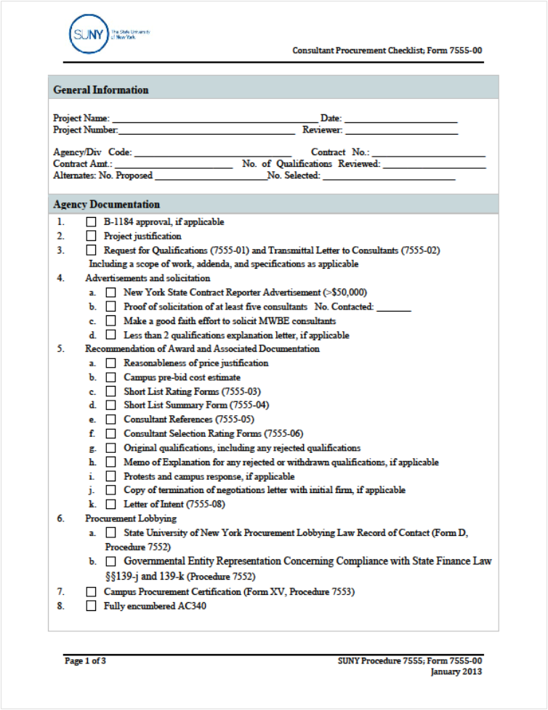
Consultant Procurement Checklist
Form 7555-01

Slide 54
Construction Related
Consultant Contracts
Contracts are negotiated with the most qualified consultant
Selections are made on the on the basis of qualifications
An RFP is required for contracts >$25,000
SUNY Procedure #7555
Construction related consultants: Architecture, engineering, geological, landscape architecture or surveying services
NYS Finance Law §136-A

Slide 55

Jessica R. Miller
Campus Let Contracts
jessica.miller@suny.edu
518-320-1129

