Slide 1


An Introduction to Campus Let Contracts
For State Operated Campuses
Regional Sessions
Spring 2025

Slide 2

Course Objectives
Increase knowledge and understanding of:
Financial Management of Capital Funds
Procurement Requirements
Consultant Selection

Slide 3

Office for Capital Facilities
Visit our Website
To be added to the CLC listserv email jessica.miller@suny.edu
Guidance Documents
Newsletters
Listservs
  AiM - Resources for Property & Asset Management
  Campus Let Contracts Program
  Community College Capital Program
  Energy Procurement and Utility Regulatory Affairs
  Residence Hall Capital Program

Slide 4
Campus Let Contracts
Guidance Documents
  CLC-1 Construction Bonds
  CLC-2 Temporary Services
  CLC-3 Construction Authority
  CLC-4 Contract Threshold Chart
  CLC-5 Division of Budget Approval B-1184
  CLC-6 Debriefing
  CLC-7 Single/Sole Source, Specific Allowances
  CLC-8 Field Orders
  CLC-9 Furniture, Fixtures and Equipment
  CLC-10 Insurance Limits
  CLC-11 Approval of Real Property Transactions
  CLC-12 Telecommunications Site Manager Agreement
  CLC-13 Facilities Procurement Purchase and Install and Service Contracts
  CLC-14 Leases and Revocable Permits
Visit our Website

Slide 5



Campus Let Contracts
Session 1:
Capital Funds

Slide 6
Learning Objective
Increase knowledge and understanding of:
  State University of New York (SUNY), the State University Construction Fund (FUND), and their Capital Programs
  Capital funding – where it comes from and how it is managed

Slide 7


What is Capital?

Slide 8
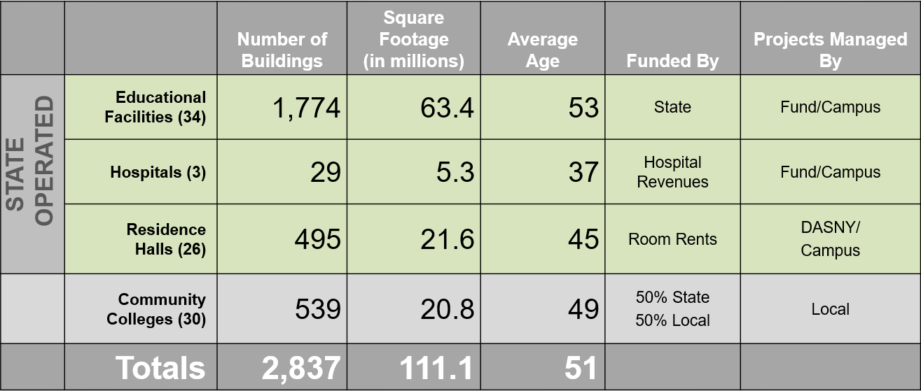
SUNY’s Capital Programs
and Physical Footprint
Data as of Fall 2024

Slide 9
Where Does Capital Funding Come From?
State-Issued / State-Supported
Bond Proceeds:
Only for State-owned Educational or Hospital facilities
Must be for an educational purpose
The asset improved or acquired must remain in state-ownership over the life of the bonds
Cannot be used on spaces occupied by private users (including federal government)
Bonds = 30 year loan

Slide 10
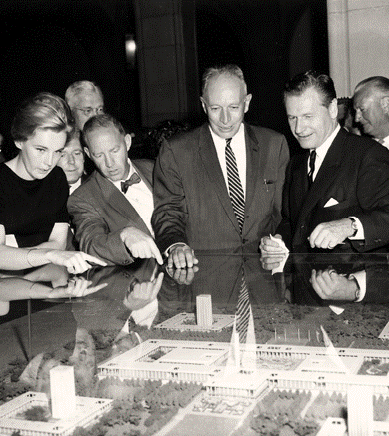
The State University Construction Fund
On March 17, 1962, in response to his Committee on Higher Education’s recommendations, Governor Nelson Rockefeller created the State University Construction Fund.
The Fund was established as a public benefit corporation, pursuant to Chapter 251 of the Laws of 1962 (Article 8A of the NYS Education Law). The Fund is administered by a Board of Trustees consisting of three members appointed by the Governor, one of whom must be a State University Trustee. Members other than the State University Trustee are also confirmed by the Senate.
In the 1962 photo at right, Governor Rockefeller (center) is shown next to Albany Mayor Erastus Corning III, viewing a model of the University at Albany campus.

Slide 11
SUNY Capital Organization & Primary Capital Programs
ORGANIZATIONAL STRUCTURE
PROGRAMS AND CONTRACT RESPONSIBILITY
Robert M. Haelen
SUNY Senior Vice Chancellor for Capital Facilities
Fund General Manager
Educational Facilities (State-operated)
Projects managed by the Fund or campuses
Supported by the State (appropriations and debt service)
Subject to the State’s bond cap
Hospital Facilities (State-operated)
  Projects managed by the Fund or campuses
  Supported by the State and Hospital revenues
  (appropriations provided by the State, debt service
  reimbursed with hospital revenues)
  Subject to the State’s bond cap
Residence Halls (State-operated)
  Projects managed by DASNY or campuses
  Supported by Room Rents (bonds issued by DASNY, debt service paid with room rents)
  No longer subject to State capital appropriations
  Revenue bonds issued by DASNY are no longer subject to the State’s bond cap
Community Colleges
  Projects managed by local community college sponsors or the campus with limited state oversight.
  Supported by local sponsor (50%) and State (50%)
  Appropriations for new projects must be appropriated in the State Budget with a supporting resolution from sponsor committing the local share
Office for
Capital Facilities
State University Construction Fund
Environmental Health & Safety
Campus Let Contracts
Community College Capital
Residence Hall Capital
Energy Procurement & Utility Regulatory Affairs
State-operated Campus Capital
Statutory Colleges Capital
Hospital Capital
Capital Budgeting & Planning
Execution of Design and Construction Contracts

Slide 12
How we all fit together…
29 State-operated Campuses
SUNY Board of Trustees
Governor’s Office
5 Statutory Colleges
Legislature
3 Teaching Hospitals
System Administration
Including the Office for Capital Facilities
State Education Department
25 Campus Residence Hall Programs
44 University-wide Programs
Division of the Budget
30 Community Colleges and Community College Trustees
Office of State Comptroller
Academic
Financial, legal etc.
Key
Outside Entities
Department of Health
The Research Foundation
for SUNY
Economic Development
State University
Construction Fund
DASNY
Policy Guidance and Direction of the System
Over 60 Institutional Entities:
ASC’s, Foundations, Alumni Associations, College Councils, CCBOA, SUBOA, NYCAP, ACT, UFS, etc.
OGS
Attorney General

Slide 13
Capital Project Management
There are two primary means of capital project management:
Fund Managed
Construction Fund acts as agent
Contracts let through the Fund
Design & Construction administration by the Fund
Campus Let (e.g., Campus Administered)
Local contracts let by the campus
Design and construction administration by campus staff
Fund Managed
Total All Funds Disbursements
Five Year - Y15/16 – FY19/20
Including Bonded Funds, Campus Funds (384), and Other Agency Suballocations

Slide 14
Campus Administered Projects
Campus Let Projects
Campus managed construction projects funded by capital appropriations through the Fund
Campus Administered Procedures apply
Campus Funded Projects
Campus managed construction projects funded by SUNY appropriations or other funds such including those from the Foundation, Research Foundation, Auxiliary Service Corporation, Alumni Association, Income Fund Reimbursable (IFR) accounts or Grants.

Slide 15
The NYS Budget Cycle and Securing State Funding Support
NYS Fiscal Year is April 1st through March 31st
SUNY and the Fund in collaboration with each campus develop a multi-year capital budget request.
Governor releases an Executive Budget in January that provides a recommended level of support for each of SUNY’s capital programs.
SUNY and the campuses engage in an advocacy effort.
A final budget, due by April 1, is enacted that provides the final level of support and establishes annual spending limits for each program.
January to March
June to September/October
AGENCY BUDGET PREPARATION
LEGISLATIVE ACTION
BUDGET EXECUTION
April to March
GOVERNOR’S DECISION
BUDGET DIVISION REVIEW
September/October to December
November to January

Slide 16

Capital Appropriations
The New York State Budget provides the appropriations that authorize spending for all of SUNY’s capital programs, except for the bonded portion of the Residence Hall program.
An appropriation is an authorization to spend money (‘new money’) for a designated purpose. This is permissive which means that additional actions and approvals are needed to access the appropriation (once enacted) and to spend the money.
A reappropriation continues all or part of the undisbursed balance of a prior appropriation (‘old money’). This is commonly used when the funding amount is intended to support activities that may span several fiscal years.
Capital funding is appropriated to the State University Construction Fund

Slide 17
$14B - SUNY Educational and Hospital Capital Appropriations History
Governor Spitzer, 2007-2008
Governor Patterson, 2008-2010
Great Recession, 2007-2009
Governor Cuomo
2011-2016
Period of unpredictable funding
Hospitals
SI and Flex
CM

Slide 18
STATE UNIVERSITY OF NEW YORK 2024 - 2026 ENACTED CAPITAL BUDGETS IN MILLIONS
Program | 2024/2025 Enacted | 2025/26 Enacted
Educational Facilities
- Critical Maintenance | $550.0 | $550.0
- Building Enhancements & New Construction and Research | 160.0 | 360.0
- Green Energy Loan Fund | - | 25.0
Subtotal, Educational Facilities | 710.0 | 935.0
Hospitals
- Maintenance & Initiatives | 150.0 | 150.0
- Downstate University Hospital (for modernization and revitalization) | - | 450.0 | *
- Downstate University Hospital (for construction and equipment) | - | 5.0
- Upstate University Hospital (for modernization and revitalization) | - | 450.0
Subtotal, Hospitals | 150.0 | 1,055.0
Residence Halls, Pay-as-you-go Capital | 75.0 | 100.0
Community Colleges, 50% State Share | 138.2 | 130.5
TOTAL | $1,073.2 | $2,220.5
*300M was enacted in 2024-25 for a total of $750M for Downstate modernization and revitalization

Slide 19
$910M 2025/26 ENACTED CAPITAL FUNDING
$550M
$153.4M
$396.6M
$360.0M
SUBOA ALLOCATION
TO CAMPUS
Existing facilities
LUMP, FUND-DISTRIBUTED
High priority critical maintenance
existing facilities
SUNY/FUND-DISTRIBUTED
Research Facility Improvements

Slide 20

$550M*
in annual funding
$9B
in backlog
*$1.6B Needed Annually
to address the rate of decay and existing Backlog

Slide 21
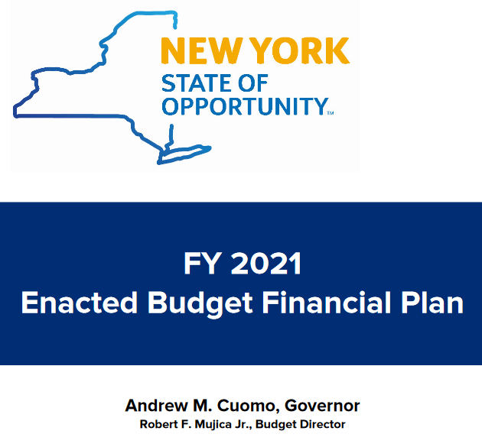
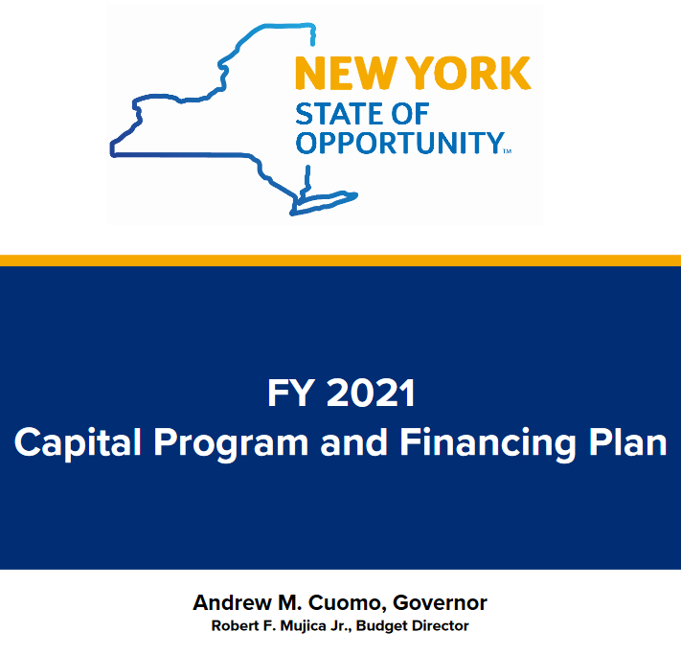
Budget Execution
New York State’s Enacted Budget Financial Plan and the Capital Program and Financing Plan are issued about 3 to 4 weeks after the budget is enacted.
These plans project State revenues and establish the annual spending limits for all State programs, including SUNY’s Capital Program.

Slide 22
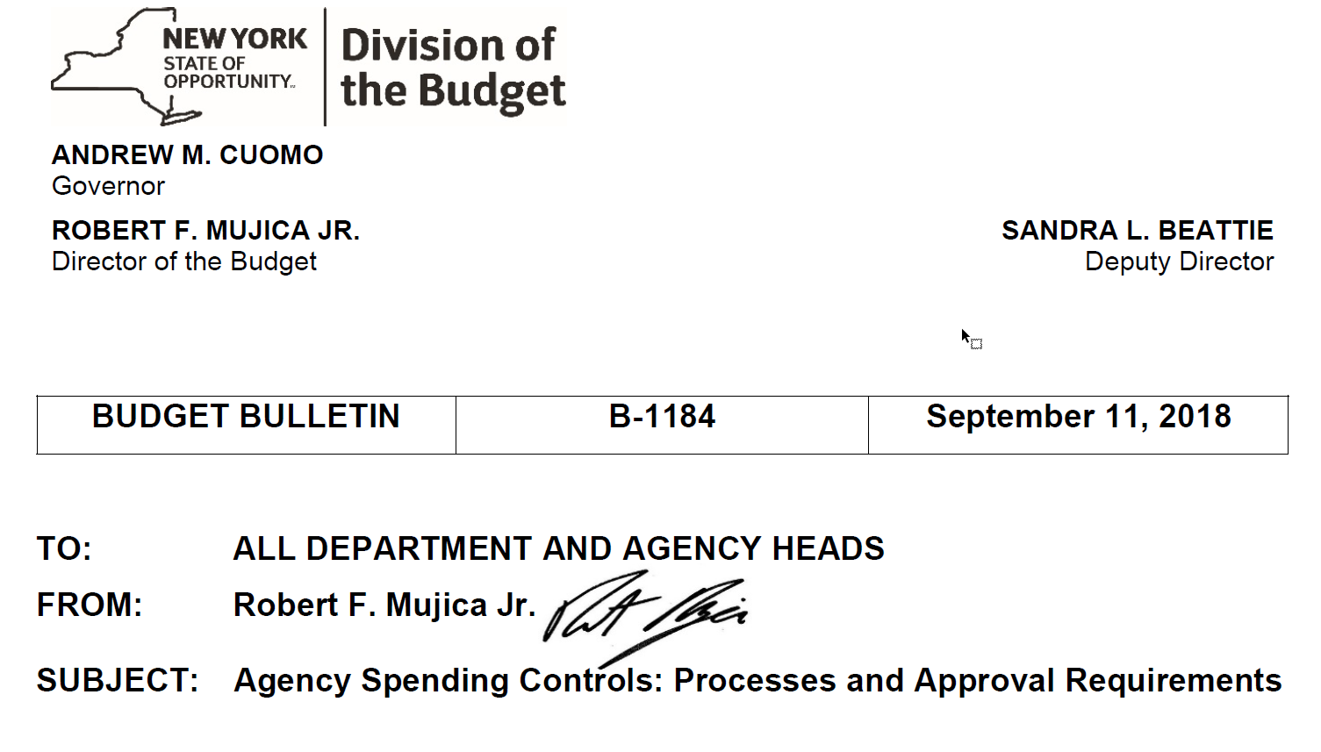
DOB Approval
Appropriations are made available, spending limits are known, and execution of the capital plan can continue.
DOB has an approval role before capital funded design or construction contracts over $1M can be awarded. DOB approves each project’s “B-1184”.
This is generally routine, and turnaround is typically about a month.

Slide 23

Authority to Spend
Disbursement target
A spending cap placed on appropriations by the Division of Budget limiting the total amount of expenditures that may be made in a specific State fiscal year.

Slide 24

Help Hit the Target - Accurate Dates
Ensure accurate dates in project requests and funding requests
Monitor the 610 report and be prompt with submitting project closeouts
Respond to update requests from the Fund on the status of projects

Slide 25

Campus Let Contracts
Memorandum of Understanding (MOU) between the Campus and the Fund
Capital Funds are bonded
Bonds come with Restrictions
Capital funding is appropriated to the State University Construction Fund

Slide 26

Management of Capital Funds
Bond Restrictions
Declaration of intent
Tax exempt vs. taxable bonds
Annual Private Use Survey
Bond proceeds must be used only for capital costs
Useful life of Project

Slide 27
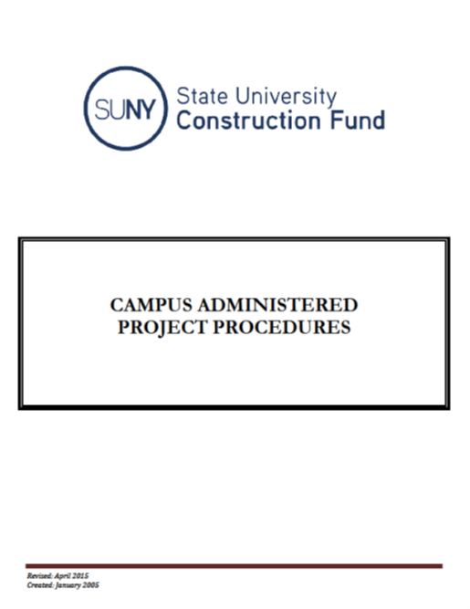
Campus Administered Procedures
Applies to Campus Let Contracts
Ties to the MOU between the Campus and the Fund
Establishes the funding process
Requires the campus to certify its compliance
Campus Administered Procedures

Slide 28
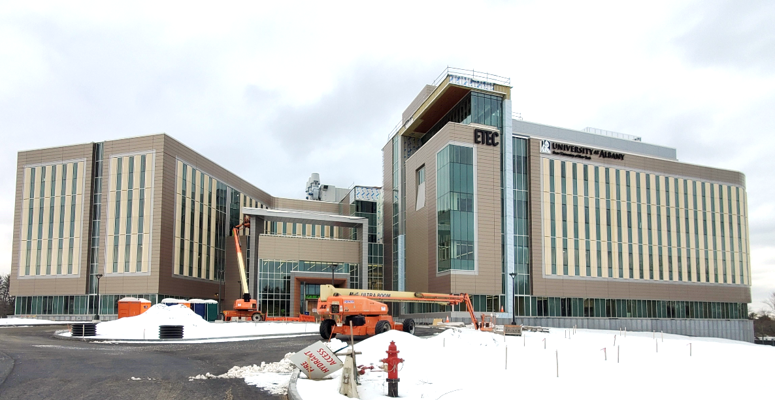
Campus Certifications
NYS Building Code
Encumber funds within 120 days
Located on SUNY property
State Environmental Quality Review Act - SEQR
SUNY Educational and related facilities

Slide 29


Operating vs. Capital Expense
Operations and Maintenance
  Budgeted staff payroll
  Utilities
  Office supplies and janitorial supplies to support regular operations
  Disposal of hazardous waste from academic or research activities
  Leased surge space
Capital
  Architecture and Engineering Studies
  Design
  Construction
  Construction Material
  Equipment - Fixed

Slide 30
Examples of “Not Capital”
Routine or recurring maintenance or operational expenses
Small scale hardware replacement
The acquisition, replacement or repair of moveable furniture, equipment, and carpeting
Indirect labor charges (management and administrative support)
General summer work crews whose purpose is to supplement staff for routine maintenance

Slide 31
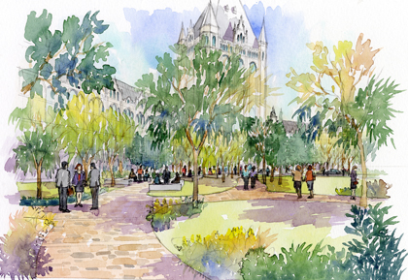

Operating vs. Capital Expense
Operations and Maintenance expense, unless done as part of a new construction or major renovation project
  Landscaping
  Painting
  Carpet
  Furniture
  Resealing, resurfacing or relining parking areas

Slide 32


Slide 33
Charging Staff to Capital
Appropriations
Professional staff (architect and/or engineer) and site representatives
    Fully dedicated to supporting capital program
    No day to day or routine responsibilities on campus
    One staff member or site representative per project
  Only payroll charges can be charged to the account
Charge the capital account directly, or
Charge one of the IFR accounts, and process journal vouchers monthly
SUNY Procedure 7302

Slide 34

Minor Critical Maintenance
Critical Maintenance projects between $5,000 and $150,000
Project completion in less than 12 months
Discrete scope
    Limited to a specific building or group of buildings
    Limited to discrete components of the building(s)
    Addresses specific aspects of the campus site or infrastructure
Project has useful life of 10 years or more
Critical Maintenance: projects to preserve facilities in good working condition, suitable for their current utilization, and compliant with all applicable codes, rules, regulations, and standards.
SUNY Procedure 7563

Slide 35
Minor Critical Maintenance
MCM Project Accounting
    SUCF establishes the master project for each campus allocation
    Sub accounts are established by the campus for each qualifying project
Capitalization for MCM
    A Project Capitalization Form is required for sub accounts over $100,000 with qualifying costs

Slide 36

Capitalization - SUNY
All land acquisitions
All buildings acquisitions
Building renovations and improvements projects costing more than $100,000
Land improvements and infrastructure projects costing more than $100,000, and,
Equipment costing more than $5,000 with a useful life beyond a single reporting period (generally one year).
Renovations are an asset.
In accounting, capitalization is when we spread the cost of an asset across the life of that asset. SUNY Procedure 7004

Slide 37
Capitalization - SUNY
Complete the SUNY Capitalization Form when:
    The project has reached substantial completion
    The asset is placed in service (beneficially occupied)
    The project costs are known and/or can be reasonably estimated
Submission of this form will NOT close out financial accounts. Outstanding payments can still be processed for the project.
Closeout Capitalization

Slide 38
Closeout – The Fund
At substantial completion update the beneficial occupancy milestones with your Fund Program Manager
When all payments have been processed and paid
    Reduce any outstanding encumbrances on the project to zero
    Submit the Account Closeout form (Attachment G) to the Fund
    Upon receipt of the Account Closeout form, the Fund will close out the associated accounts and return any unexpended balances to the campus’ balance account.
Closeout Capitalization

Slide 39
Project Labor Agreements
A Project Labor Agreement (PLA) is a pre-hire collective bargaining agreement with one or more trade labor organizations that establishes the terms and conditions of employment for workers employed on a specific construction project. Project Labor Agreement provisions typically include items such as wage rates, fringe benefits, apprentice ratios, work schedules, hiring practices, no strike/lockout/slowdown clauses, and dispute resolution clauses.

Slide 40
Project Labor Agreements
Effective: Bids advertised January 1, 2025, or later
Required on projects of $10M or more when a feasibility study shows that the PLA will do one of the following:
  Result in the best work at the lowest possible price;
  Prevent favoritism, fraud and corruption;
  Reduce project delays;
  Potentially generate cost savings; or
  Prevent labor unrest.
A PLA Study MUST be completed

Slide 41
Project Labor Agreements
Contracts >$10M
Procure Design Services
Design services are procured first.
When schematic design is complete, and the design has sufficient details on budget and trades needed to complete the work, a PLA study can be procured.
Procure a PLA Study
Once complete the feasibility study is assessed by the campus to determine if a PLA would be beneficial or not under Labor Law 222.
Procure a Construction Management firm
Procure a CM to negotiate and be the signatory to the PLA. The PLA must be complete prior to releasing the Invitation for Bid for construction.
PLAs are put in place BEFORE putting construction out to bid

Slide 42
Recap
Public administrators overseeing public money
Appropriations are permissive. B-1184 approvals are required for projects funded with capital
SUNY’s capital program is funded with bond proceeds; bonds come with restrictions.
  Capital funding can only be used for capital expenses that extend the useful life of an asset.
  Funding must be used for it’s intended purpose, closeout accounts and put unused funding back.

Slide 43
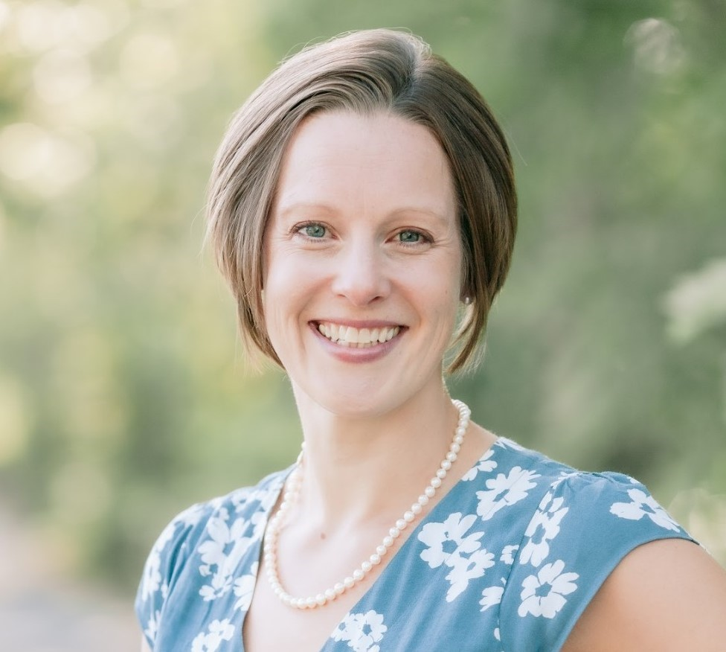
Jessica R. Miller
Campus Let Contracts
jessica.miller@suny.edu
518-320-1129

